Slide 1
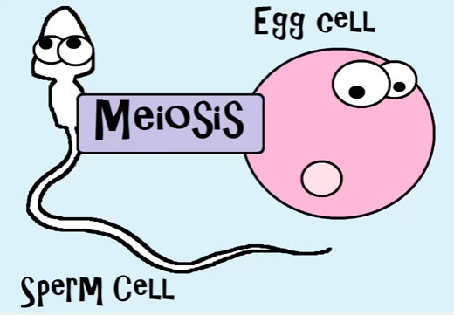
CLASS OPENER Video
OPEN and WATCH the video!
QUESTION: What kind of cells are being made in Meiosis?
CLASS will start when the timer goes off!
This should give you PLENTY of time to WATCH the whole video! Unless you are REALLY late for class – then watch the video AFTER class!
Notes:
Meiosis (7:40) https://www.youtube.com/watch?v=toWK0fIyFlY

Slide 2
Reproduction: Meiosis
CLASS OPENER
I have my Study Guide.
If you do not have it, it was emailed or is in the Life Science Study Guides Module.
Study Guide for Quiz 16 Reproduction
OPEN it now! ☺
LOG IN!
LESSON

Slide 3
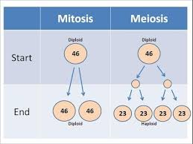
Objectives
Students will …
Describe the similarities and differences of physical characteristics in diverse organisms.
Compare and contrast observable patterns in physical characteristics across families, strains, and species.

Slide 4
Popcorn Time
LOG INTO Your BrainPOP account!
CLICK on the video link!
RED X you are watching the video OR use the Study Guide
Green check when you are done!
QUESTION: How do cells divide?
Notes:
BrainPop Mitosis (2:09)
Mitosis:
https://www.brainpop.com/science/cellularlifeandgenetics/mitosis/

Slide 5
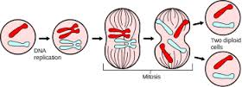
Remember, Mitosis?
Mitosis – cell division that creates two body cells
when the DNA of the nucleus splits into two identical nuclei making two body cells that each contain a full set of the chromosomes
NOTE: This is how body cells reproduce to make MORE body cells!!!

Slide 6
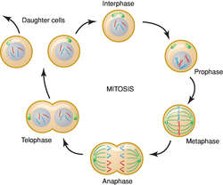
CHECK QUESTION
Cell division that creates two body cells that contain a full set of the chromosomes is called … ?
Mitosis
Meiosis
Cell duplication

Slide 7
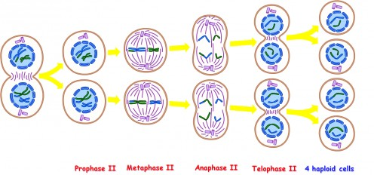
Meiosis
Meiosis – cell division that creates four sex cells (either eggs or sperm)
when the DNA is split into four nuclei to make four sex cells with half the DNA, or chromosomes, in each cell

Slide 8
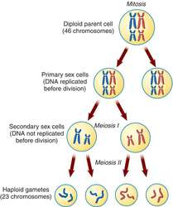
CHECK QUESTION
Cell division that creates four sex cells that contain a half a set of the chromosomes is called … ?
Mitosis
Meiosis
Cell duplication

Slide 9
Mitosis vs Meiosis
MITOSIS MEIOSIS
Makes what kind of cells?
With how many chromosomes?
Makes what kind of cells?
With how many chromosomes?

Slide 10
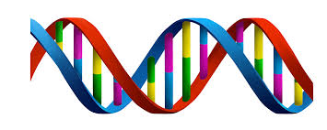
CHECK QUESTION
Whether in mitosis or meiosis, what has to be duplicated to make the new cells?
NBA
NFL
DNA

Slide 11
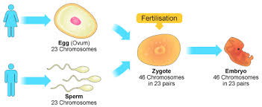
Cells for Reproduction
Sex Cells or Gametes – eggs and sperm; have HALF the chromosomes of the organism
Eggs – female sex cell; half the chromosomes
Sperm – male sex cell; half the chromosomes
Zygote – formed as a result of fertilization; when the gametes (egg and sperm) join to complete the full set of chromosomes and start the creation of the new organism
A genetically mixed offspring – half of the traits from the mother and half from the father

Slide 12
CHECK QUESTION
Sex cells or gametes, also known as eggs and sperm, which have half the chromosomes of the organism in them are made during which type of cell division?
Mitosis
Meiosis
Cell duplication

Slide 13
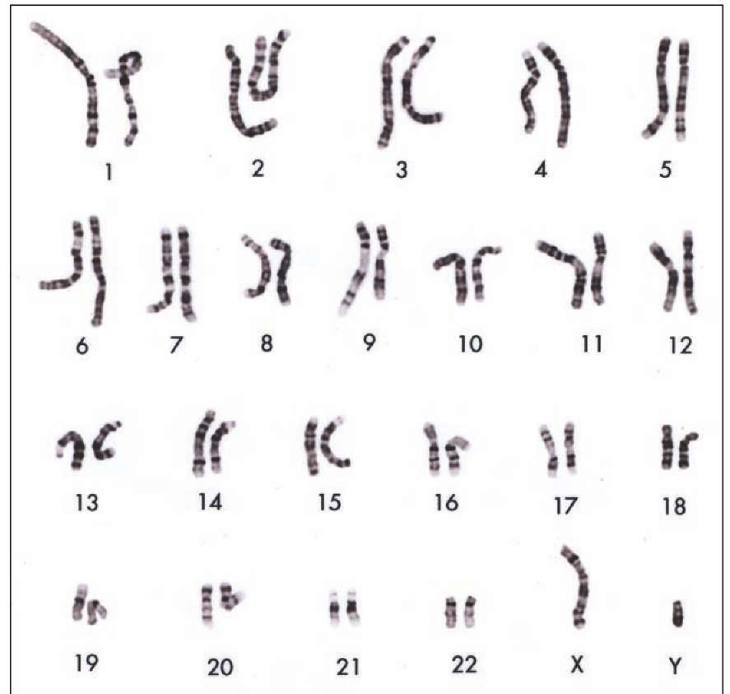
CHECK QUESTION
A zygote is formed as a result of fertilization which is when the egg and sperm join completing a full set of … ?
DNA
chromosomes
Either term could be used.

Slide 14
EXIT TICKET
Click on the link in chat or here:
Give a Green Check when you are finished.
I will check your answers and move you to the Dismissal Room
Notes:
Link in Class

Slide 15
Are you CAUGHT UP?
UPCOMING END DATES for:
Quiz 14
1-10-18 Writing Wednesday
Quiz 15
CHECK the Life Science Course for OVERDUE work!
If you READ the board, you are DISMISSED!!

