Slide 1



Before we start…
DID you do your Homework?
Homework
FOR TODAY YOU WILL NEED…
  Your Microscope
  Microscope Slides
  Cover Slips
  The Letter “e” cut out of a newspaper or magazine
  Any one of the following things… a piece of fabric, sand, a paper bill, moss, pine needle, insect part, feathers
YESTERDAY’s EXIT TICKET
If you didn’t do it, do it now! OR complete again to watch the videos over
  LINK:
OR IF you are ready for class, try the Virtual Microscope again!
  LINK:
I am ready for class!
Notes:
http://www.udel.edu/biology/ketcham/microscope/scope.html

Slide 2
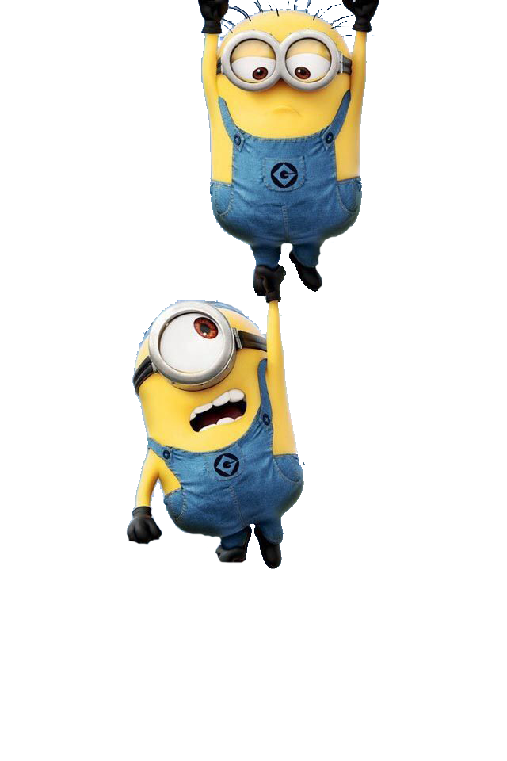



Microscope Lab
CLASS OPENER
Scientists use microscopes to make objects look smaller than they are.
We’ll be using the
Quiz 5_Cells Study Guide today!

Slide 3
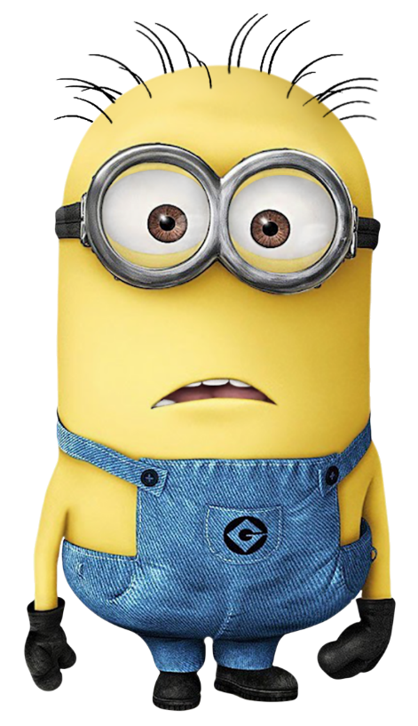
Objectives
Students will …
Identify the parts of a compound microscope
Making and using slides to examine
Using the microscope
I have the
Quiz 5_Cells Study Guide
OPEN!

Slide 4
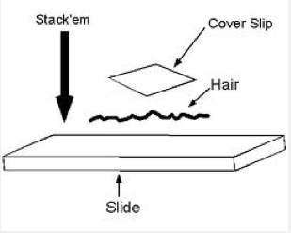
Dry Mount Slide
Quiz 5_Cells Study Guide
Dry Mount Preparation
In a dry mount, the specimen is placed directly on the slide.
A cover slip (or another slide) may be used to keep the specimen in place and to help protect the objective lens.
Dry mounts are suitable for specimens such as samples of pollen, hair, feathers or plant materials.

Slide 5



YOUR TURN: Dry Mount Slide
Quiz 5_Cells Study Guide
Dry Mount Preparation
PICK your item (such as one above), and create a dry mount slide
THEN, set it aside.
  Make sure to HOLD the slide and/or coverslip by the EDGES of the slide!
I am making my slide.
My slide is ready!

Slide 6

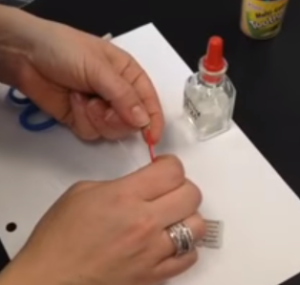
POPCORN TIME:
Wet Mount Slide of the Letter “e”
CLICK on the video link!
RED X you are watching the video
Green check when you have the answer!
Be prepared to answer:
What will you need to get to make this slide?
(that you do not have yet)
WHY haven’t I told you to get this yet?
Notes:
Wet Mount Slide of the letter e (1:17) https://www.youtube.com/watch?v=msPQPwOa5J8

Slide 7

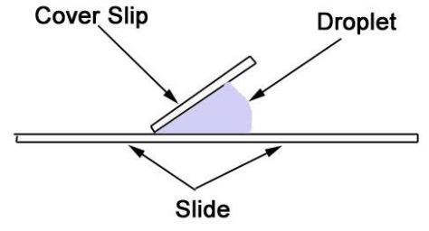
YOUR TURN:
Preparing a Wet Mount Slide
Quiz 5_Cells Study Guide
Place a sample (the letter “e”) on the slide.
Using a pipette, place a drop of water on the specimen (the letter “e”).
Then place on edge of the cover slip over the sample (at a 45 degree angle) and carefully lower the cover slip into place.
  This method will help prevent air bubbles from being trapped under the cover slip.
THEN, set it aside.
  Make sure to HOLD the slide
  and/or coverslip by the EDGES
  of the slide!
I am making my slide.
My slide is ready!

Slide 8

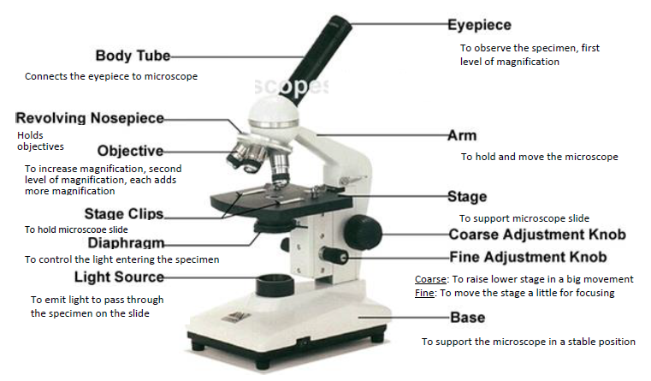
FROM the Study Guide!
Quiz 5_Cells Study Guide

Slide 9
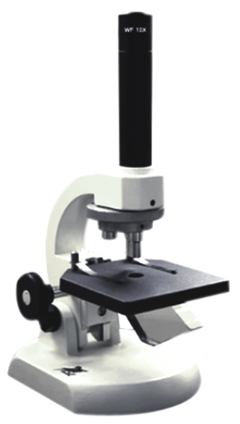
OUR k12 Microscope
Eyepiece
Body tube
Arm
Revolving nosepiece
Objectives
4x, 10x, 40x
Stage clips
Adjustment Knob
(JUST the ONE)
DO NOT USE the 40x objective
Stage
Light source
You MUST have LIGHT
Enter the end of the prism!
arm
Base
under the base
Base

Slide 10

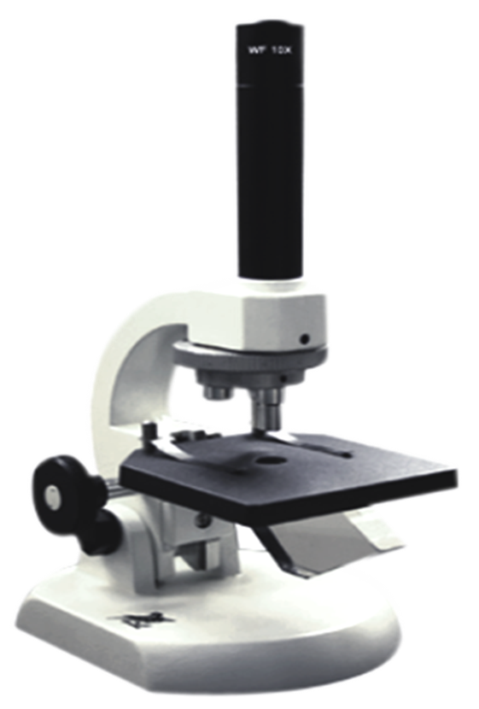

Pulse Check!!
WHY should you NOT use the 40x Objective
on the k12 Microscope?
    There is no fine adjustment knob
    We can’t really see anything with it
    We could run the objective into
    the slide and break it
    Actually, ALL of these are true!

Slide 11

USING Our k12 Microscope
Set your microscope on a tabletop or other flat, sturdy surface.
Align a light to hit the END of the prism on the microscope
– LOOK through the scope to see if you see light
    not sure, TURN OFF the light and look again.
Rotate the nosepiece to the lowest-power objective (4x)
Place one of your prepared slides (dry mount or the letter “e”) onto the stage
Adjust the focus knob until the specimen is in focus
Rotate nosepiece to the next objective (10x).
Carefully/gently, adjust the focus knob until the specimen is in focus
For fun: DRAW what you see!
REPEAT ALL steps to view your second slide!

Slide 12
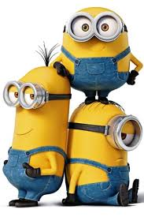

Before you go…
Click on the link in chat or here:
Give a Green Check when you are finished.
  I will check your answers and move you to the Dismissal Room
Notes:
Link in Class

Slide 13

REMEMBER:
11-8 ASYNCH Lesson must be completed by the END DATE
Wednesday, Nov 22
You are Dismissed!

