Slide 1
Group Science ESCAPE Room

Slide 2
Group Science ESCAPE Room
RULES
Your TEAM’S success depends on YOU!

Slide 3
Group ESCAPE Room
WORK as a GROUP
USE: chat, mic, board tools
TASK: Complete the Venn Diagram for Single Celled vs. Multicellular Organisms.
USE: the Study Guide
YOU MUST complete the work on the FIRST slide to see the SECOND slide, you must complete the work on the SECOND slide to see the THIRD slide!
CAN you complete the TASK in 5 minutes!
To have you slide checked, ALL team members MUST give a green check!!

Slide 4
Single vs Multicellular Organisms
WORK as a TEAM! …use chat, mic and board tools!
Single Celled Organisms
To have you slide checked, ALL team members MUST give a green check!!
1 of 3 slides
ON this slide, YOU NEED:
TWO FACTS about single celled organisms
And, ONE picture of a single celled organism.

Slide 5
Single vs Multicellular Organisms
WORK as a TEAM! …use chat, mic and board tools!
Multicellular Organisms
To have you slide checked, ALL team members MUST give a green check!!
2 of 3 slides
ON this slide, YOU NEED:
TWO FACTS about multicellular organisms
And, ONE picture of a multicellular organism

Slide 6
Single vs Multicellular Organisms
WORK as a TEAM! …use chat, mic and board tools!
BOTH
Single celled and Multicellular Organisms
To have you slide checked, ALL team members MUST give a green check!!
3 of 3 slides
ON this slide, YOU NEED:
TWO FACTS about BOTH Single Celled and Multicellular Organisms

Slide 7
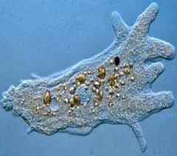
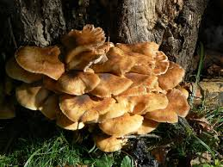
Single vs Multicellular Organisms
Wait Patiently while others finish!
Single Celled Organisms
Multicellular Organisms
MORE than ONE cell
Requires cellular organization from cells to organ system; has to be MORE than ONE cell!
Eukaryotic
ONE cell
Prokaryotic OR Eukaryotic
Made of Cells &
Living

Slide 8
Single vs Multicellular Organisms
Single Celled Organisms
Multicellular Organisms
MORE than ONE cell
Requires cellular organization from cells to organ system; has to be MORE than ONE cell!
Eukaryotic
ONE cell
Prokaryotic OR Eukaryotic
Made of Cells &
Living

